Slide 1

2
0
1
7
2017年终总结
2017Year-end summary
汇报人：王绪楠
2018年1月6日

Slide 2
目 录
1
教学部份
2
教学部工作
3
经验教训
4
未来计划

Slide 3
1
教学部份

Slide 4
教学工作
Java
前端
Java
Java
1701
1701
1704
1706

Slide 5
2
教学部工作

Slide 6
教学部工作
出差北京
辅助修改教学大纲
新技术的细节实现
整理范例程序及文档

Slide 7
3
经验教训

Slide 8
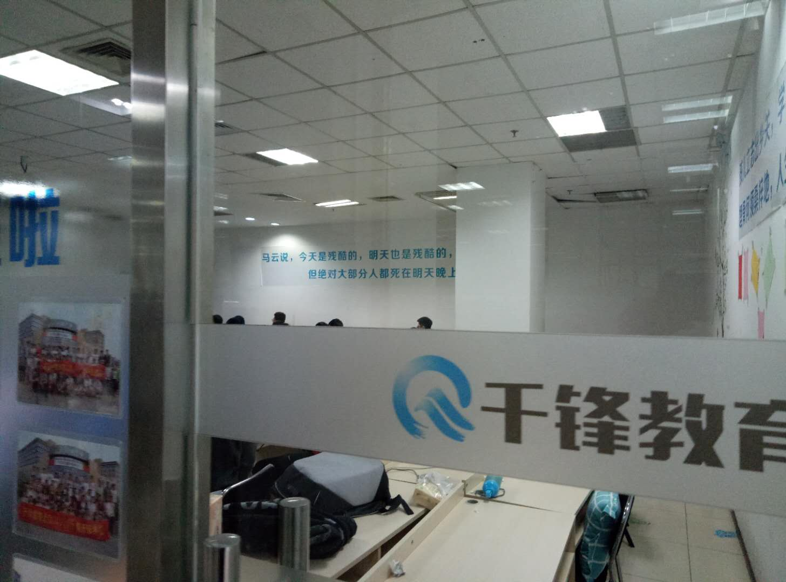
经验教训
马云说：今天是残酷的，明天也是残酷的，但绝对大部分人都死在明天晚上。

Slide 9
4
未来计划

Slide 10
未来计划
Postgres
QL
Vue
React
学习更好的技术，做更好的教师。
Node.js
Spring
Cloud
Python

Slide 11
2
0
1
8
感谢观看
THANK YOU FOR WATCHING
汇报人：王绪楠
2017.12.31

Slide 12
目 录
1
本人教学情况
Insert Header Topic Here
2
此处添加标题文本
Insert Header Topic Here
3
此处添加标题文本
Insert Header Topic Here
4
此处添加标题文本
Insert Header Topic Here

Slide 13
1
教学部份

Slide 14


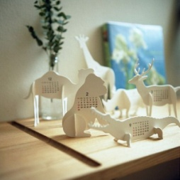





WRITE YOUR GREAT TITLE HERE
This is a good space for a short subtitle
INSERT HEADER TITLE IN AREA
We have many PowerPoint templates that has been specifically designed to help anyone that is stepping into the world of PowerPoint for the very first time. We have many PowerPoint templates that has been specifically designed to help anyone that is stepping into the world of PowerPoint for the very first time.
We have many PowerPoint templates that has been specifically designed to help anyone that is stepping into the world of PowerPoint for the very first time. We have many PowerPoint templates that has been specifically designed to help anyone that is stepping into the world of PowerPoint for the very first time.
We have many PowerPoint templates that has been specifically designed to help anyone that is stepping into the world of PowerPoint for the very first time. We have many PowerPoint templates that has been specifically designed to help anyone that is stepping into the world of PowerPoint for the very first time.
Head Title
We have many PowerPoint templates that has been specifically designed.

Slide 15
WRITE YOUR GREAT TITLE HERE
This is a good space for a short subtitle
01
We have many PowerPoint templates that has been specifically designed to help anyone that is stepping into the world of PowerPoint for the very first time.
02
We have many PowerPoint templates that has been specifically designed to help anyone that is stepping into the world of PowerPoint for the very first time.
03
We have many PowerPoint templates that has been specifically designed to help anyone that is stepping into the world of PowerPoint for the very first time.
04
We have many PowerPoint templates that has been specifically designed to help anyone that is stepping into the world of PowerPoint for the very first time.
05
We have many PowerPoint templates that has been specifically designed to help anyone that is stepping into the world of PowerPoint for the very first time.
06
We have many PowerPoint templates that has been specifically designed to help anyone that is stepping into the world of PowerPoint for the very first time.

Slide 16
WRITE YOUR GREAT TITLE HERE
This is a good space for a short subtitle
2012
2013
2014
2015
HEAD INFO HERE
We have many PowerPoint templates that has been specifically designed.
HEAD INFO HERE
We have many PowerPoint templates that has been specifically designed.
HEAD INFO HERE
We have many PowerPoint templates that has been specifically designed.
HEAD INFO HERE
We have many PowerPoint templates that has been specifically designed.

Slide 17

WRITE YOUR GREAT TITLE HERE
This is a good space for a short subtitle
TOPIC HEADER ONE
We have many PowerPoint templates that has been specifically designed.
WRITE YOUR
GREAT TITLE HERE
We have many PowerPoint templates that has been specifically designed to help anyone that is stepping into the world of PowerPoint for the very first time. We have many PowerPoint templates that has been specifically designed to help anyone that is stepping into the world of PowerPoint for the very first time.
TOPIC HEADER TWO
We have many PowerPoint templates that has been specifically designed.
TOPIC HEADER THREE
We have many PowerPoint templates that has been specifically designed.
TOPIC HEADER FOUR
We have many PowerPoint templates that has been specifically designed.

Slide 18
2
此处添加标题文本
Insert Header Topic Here
We have many PowerPoint templates that has been specifically designed to help anyone that is stepping into the world of PowerPoint for the very first time.

Slide 19




WRITE YOUR GREAT TITLE HERE
This is a good space for a short subtitle
TOPIC HEADER ONE
We have many PowerPoint templates that has been specifically designed to help anyone that is stepping into the world of PowerPoint for the very first time.
TOPIC HEADER THREE
We have many PowerPoint templates that has been specifically designed to help anyone that is stepping into the world of PowerPoint for the very first time.
TOPIC HEADER TWO
We have many PowerPoint templates that has been specifically designed to help anyone that is stepping into the world of PowerPoint for the very first time.
TOPIC HEADER FOUR
We have many PowerPoint templates that has been specifically designed to help anyone that is stepping into the world of PowerPoint for the very first time.

Slide 20
WRITE YOUR GREAT TITLE HERE
This is a good space for a short subtitle
10%
TECHNOLOGH
$50M
Marketing Information
We have many PowerPoint templates that has been specifically designed.
Insert content in this area
We have many PowerPoint templates that has been specifically designed to help anyone that is stepping into the world of PowerPoint for the very first time. We have many PowerPoint templates that has been specifically designed to help anyone that is stepping into the world of PowerPoint for the very first time.
We have many PowerPoint templates that has been specifically designed to help anyone that is stepping into the world of PowerPoint for the very first time.
We have many PowerPoint templates that has been specifically designed.
20%

Slide 21






WRITE YOUR GREAT TITLE HERE
This is a good space for a short subtitle
HEADER TITLE
We have many PowerPoint templates that has been specifically designed to help anyone that is stepping into the world of PowerPoint for the very first time.
67
EMPLOYEES
67
EMPLOYEES
HEADER TITLE
We have many PowerPoint templates that has been specifically designed to help anyone that is stepping into the world of PowerPoint for the very first time.
10
OFFICES
HEADER TITLE
67
EMPLOYEES
67
EMPLOYEES
We have many PowerPoint templates that has been specifically designed to help anyone that is stepping into the world of PowerPoint for the very first time.

Slide 22
WRITE YOUR GREAT TITLE HERE
This is a good space for a short subtitle
We have many PowerPoint templates that has been specifically designed to help anyone that is stepping into the world of PowerPoint for the very first time.
We have many PowerPoint templates that has been specifically designed to help anyone that is stepping into the world of PowerPoint for the very first time.
We have many PowerPoint templates that has been specifically designed to help anyone that is stepping into the world of PowerPoint for the very first time.
We have many PowerPoint templates that has been specifically designed to help anyone that is stepping into the world of PowerPoint for the very first time.
We have many PowerPoint templates that has been specifically designed to help anyone that is stepping into the world of PowerPoint for the very first time.
We have many PowerPoint templates that has been specifically designed to help anyone that is stepping into the world of PowerPoint for the very first time.
We have many PowerPoint templates that has been specifically designed to help anyone that is stepping into the world of PowerPoint for the very first time.
We have many PowerPoint templates that has been specifically designed to help anyone that is stepping into the world of PowerPoint for the very first time.

Slide 23
WRITE YOUR GREAT TITLE HERE
This is a good space for a short subtitle
TOPIC HEADER
We have many PowerPoint templates that has been specifically designed to help anyone that is stepping into the world of PowerPoint for the very first time.
TOPIC HEADER
We have many PowerPoint templates that has been specifically designed to help anyone that is stepping into the world of PowerPoint for the very first time.
TOPIC HEADER
We have many PowerPoint templates that has been specifically designed to help anyone that is stepping into the world of PowerPoint for the very first time.
TOPIC HEADER
We have many PowerPoint templates that has been specifically designed to help anyone that is stepping into the world of PowerPoint for the very first time.
TOPIC HEADER
We have many PowerPoint templates that has been specifically designed to help anyone that is stepping into the world of PowerPoint for the very first time.
TOPIC HEADER
We have many PowerPoint templates that has been specifically designed to help anyone that is stepping into the world of PowerPoint for the very first time.

Slide 24
WRITE YOUR GREAT TITLE HERE
This is a good space for a short subtitle
S
w
Strengths
We have many PowerPoint templates that has been specifically designed.
Weakness
We have many PowerPoint templates that has been specifically designed.
O
T
Opportunities
We have many PowerPoint templates that has been specifically designed.
Threats
We have many PowerPoint templates that has been specifically designed.

Slide 25


WRITE YOUR GREAT TITLE HERE
This is a good space for a short subtitle
Head Title
We have many PowerPoint templates that has been specifically designed to help anyone that is stepping into the world of PowerPoint for the very first time.
1
4
Head Title
We have many PowerPoint templates that has been specifically designed to help anyone that is stepping into the world of PowerPoint for the very first time.
Head Title
We have many PowerPoint templates that has been specifically designed to help anyone that is stepping into the world of PowerPoint for the very first time.
2
5
Head Title
We have many PowerPoint templates that has been specifically designed to help anyone that is stepping into the world of PowerPoint for the very first time.
Head Title
We have many PowerPoint templates that has been specifically designed to help anyone that is stepping into the world of PowerPoint for the very first time.
3
6
Head Title
We have many PowerPoint templates that has been specifically designed to help anyone that is stepping into the world of PowerPoint for the very first time.

Slide 26


WRITE YOUR GREAT TITLE HERE
This is a good space for a short subtitle
01 BUSINESS SECTION
We have many PowerPoint templates that has been specifically designed to help anyone that is stepping into the world of PowerPoint for the very first time.
WHAT MAKES US DIFFERENT ?
We have many PowerPoint templates that has been specifically designed to help anyone that is stepping into the world of PowerPoint for the very first time. We have many PowerPoint templates that has been specifically designed to help anyone that is stepping into the world of PowerPoint for the very first time. We have many PowerPoint templates that has been specifically designed to help anyone that is stepping into the world of PowerPoint for the very first time. We have many PowerPoint templates that has been specifically designed to help anyone that is stepping into the world of PowerPoint for the very first time. We have many PowerPoint templates that has been specifically designed to help anyone that is stepping into the world of PowerPoint for the very first time. We have many PowerPoint templates that has been specifically designed to help anyone that is stepping into the world of PowerPoint for the very first time.
02 BUSINESS SECTION
We have many PowerPoint templates that has been specifically designed to help anyone that is stepping into the world of PowerPoint for the very first time.
We have many PowerPoint templates that has been specifically designed.
We have many PowerPoint templates that has been specifically designed.

Slide 27
3
此处添加标题文本
Insert Header Topic Here
We have many PowerPoint templates that has been specifically designed to help anyone that is stepping into the world of PowerPoint for the very first time.

Slide 28
WRITE YOUR GREAT TITLE HERE
This is a good space for a short subtitle
Head Title
We have many PowerPoint templates that has been specifically designed to help anyone that is stepping into the world of PowerPoint for the very first time.
Head Title
We have many PowerPoint templates that has been specifically designed to help anyone that is stepping into the world of PowerPoint for the very first time.
Head Title
We have many PowerPoint templates that has been specifically designed to help anyone that is stepping into the world of PowerPoint for the very first time.
Head Title
We have many PowerPoint templates that has been specifically designed to help anyone that is stepping into the world of PowerPoint for the very first time.
Head Title
We have many PowerPoint templates that has been specifically designed to help anyone that is stepping into the world of PowerPoint for the very first time.
Head Title
We have many PowerPoint templates that has been specifically designed to help anyone that is stepping into the world of PowerPoint for the very first time.

Slide 29

WRITE YOUR GREAT TITLE HERE
This is a good space for a short subtitle
“
Weekday Sales
We have many PowerPoint templates that has been specifically designed.
85%
We have many PowerPoint templates that has been specifically designed to help anyone that is stepping into the world of PowerPoint for the very first time.
WHAT MAKES US
DIFFERENT?
We have many PowerPoint templates that has been specifically designed to help anyone that is stepping into the world of PowerPoint for the very first time. We have many PowerPoint templates that has been specifically designed to help anyone that is stepping into the world of PowerPoint for the very first time.
Weekend Sales
We have many PowerPoint templates that has been specifically designed.

Slide 30
WRITE YOUR GREAT TITLE HERE
This is a good space for a short subtitle
OPTION 02
We have many PowerPoint templates that has been specifically designed to help anyone that is stepping into the world of PowerPoint for the very first time.
OPTION 04
We have many PowerPoint templates that has been specifically designed to help anyone that is stepping into the world of PowerPoint for the very first time.
OPTION 01
We have many PowerPoint templates that has been specifically designed to help anyone that is stepping into the world of PowerPoint for the very first time.
OPTION 03
We have many PowerPoint templates that has been specifically designed to help anyone that is stepping into the world of PowerPoint for the very first time.
OPTION 05
We have many PowerPoint templates that has been specifically designed to help anyone that is stepping into the world of PowerPoint for the very first time.
2012
2014
2011
2013
2015

Slide 31
WRITE YOUR GREAT TITLE HERE
This is a good space for a short subtitle
出差北京
修改教学大纲
TOPIC HEADER THREE
We have many PowerPoint templates that has been specifically designed to help anyone that is stepping into the world of PowerPoint for the very first time.
TOPIC HEADER FOUR
We have many PowerPoint templates that has been specifically designed to help anyone that is stepping into the world of PowerPoint for the very first time.

Slide 32
2
0
1
8
感谢各位领导莅临指导
THANK YOU FOR WATCHING
汇报人：PPTS
2017.12.31

